Slide 1
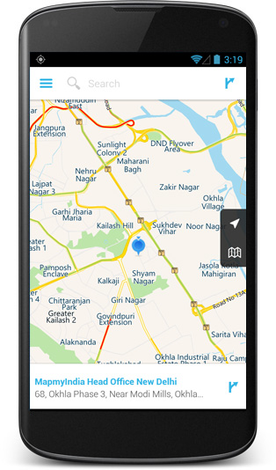
Jonathan Westerfield, Memory Boi
Summary: This app will help you recreate lost memories
Activity 1: This activity will let you scroll through
previous location tags and their pictures
Activity 2: This activity will take a picture and
tag your location
Device features in Interaction: List to choose past
locations, map of past location tags
Sensor: The camera will be used to take pictures
Notification: You will be notified if you are close to a
location you took a picture at
Google APIs Used: Google Maps
Firebase: Storing the photo and the location

